Slide 1
Training Evaluation Applied Data Science Project Summary
Cinnamon Johnson,
Elia Kostyrka,
Eric Rodgers,
& Christopher Veizaga
Audience: Claims Department

Slide 2
Introduction: Project Scope
Training evaluation from assessments administered in November and December 2018 to an undisclosed audience.
The assessments aimed to identify participants who were unfamiliar with a new electronic management system in order to provide remediation in the form of self-paced training.
Data set overview:
Learner Profile information
Demographic Questions responses
Pretest scores
Posttest scores
Post evaluation survey responses
The team focused on six business questions to identify key findings to potentially assist management in determining areas of special interest for follow-on action.

Slide 3
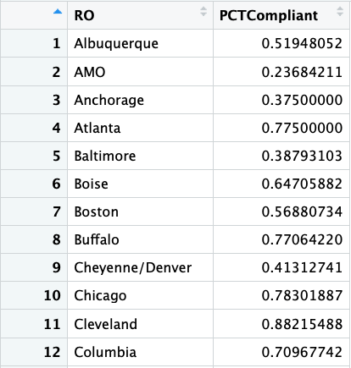
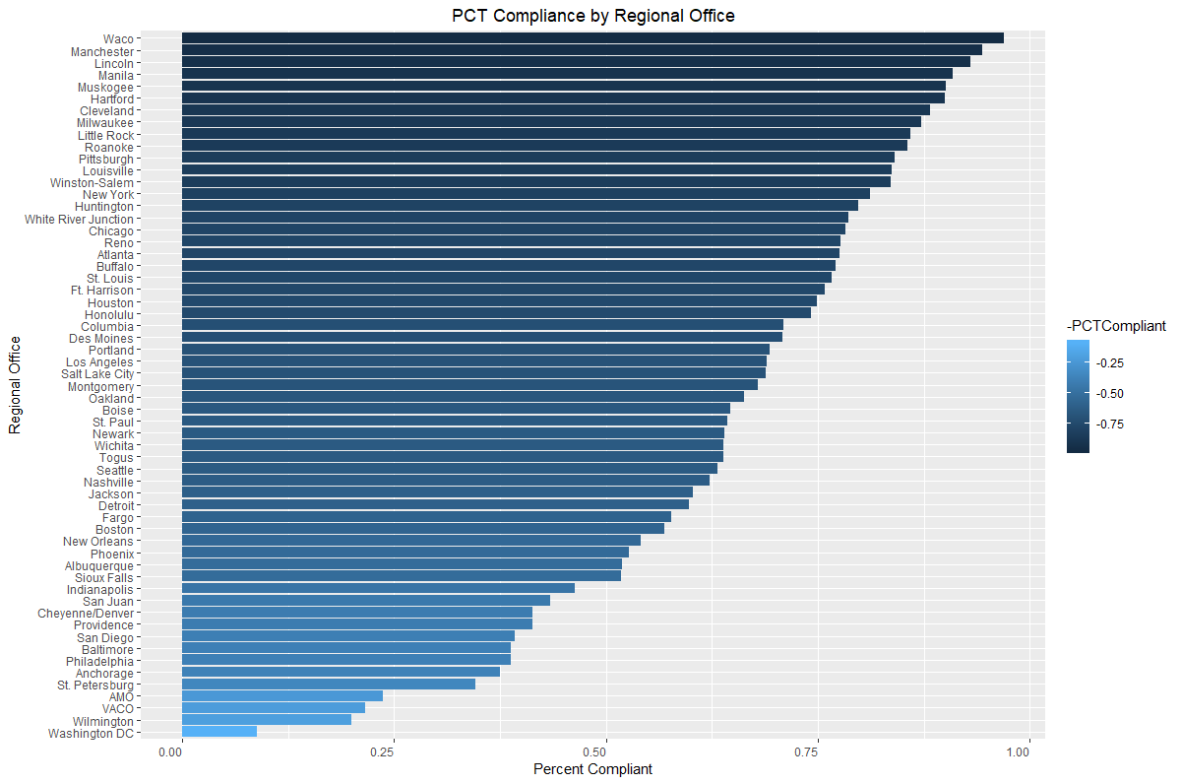
Question 1. What was the compliance rate by Regional Office?
The compliance rate represents the amount of participants who scored a 100% on the pre-test or (if necessary) went through remediation and scored 100% on the posttest.
Recommendation: Focus our efforts on the regional sites that have a compliance rate below 70 percent (36 sites), have these sites rectified within one year from now.

Slide 4
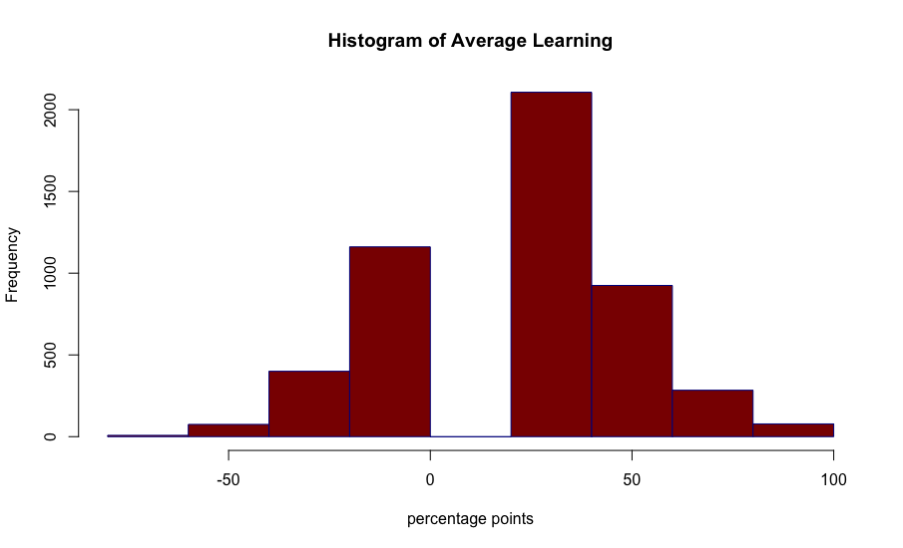
Question 2. How much learning occurred overall?
Training was successful in increasing test scores by 23 points for all participants who required remediation. The average pretest score by Regional Office was 55.61 and the average posttest score was 78.18.

Slide 5
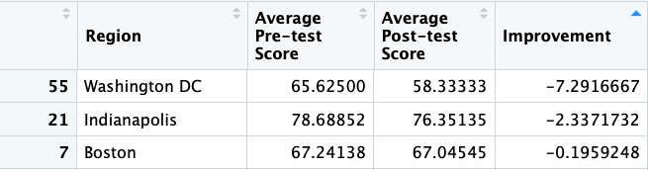
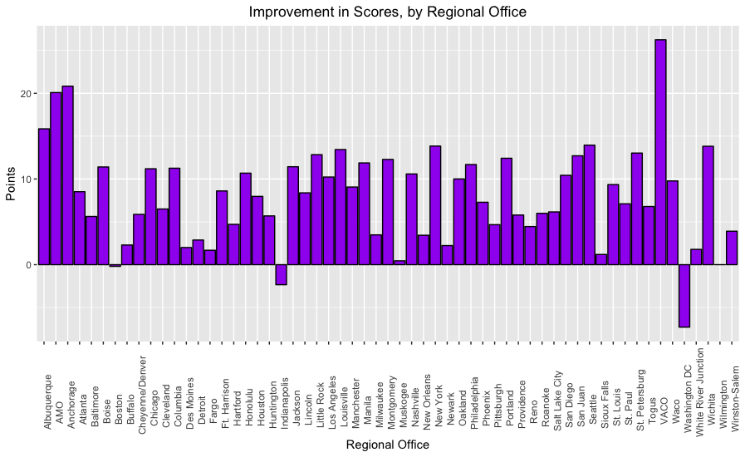
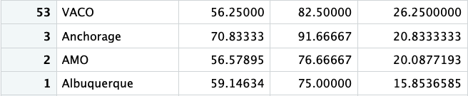
Question 3. What was the average pre-test and post-test score by Regional Office?
Average pretest and posttest scores were calculated by region. The “Improvement” column gives an idea of how well different regions responded to remediation.
Recommendation: Focus on regional offices with negative improvement: Washington, D.C., Indianapolis, and Boston.

Slide 6
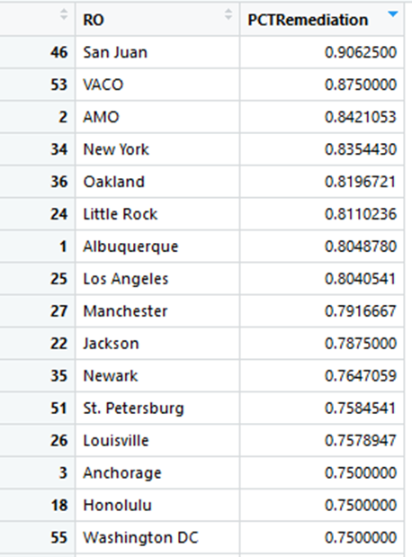
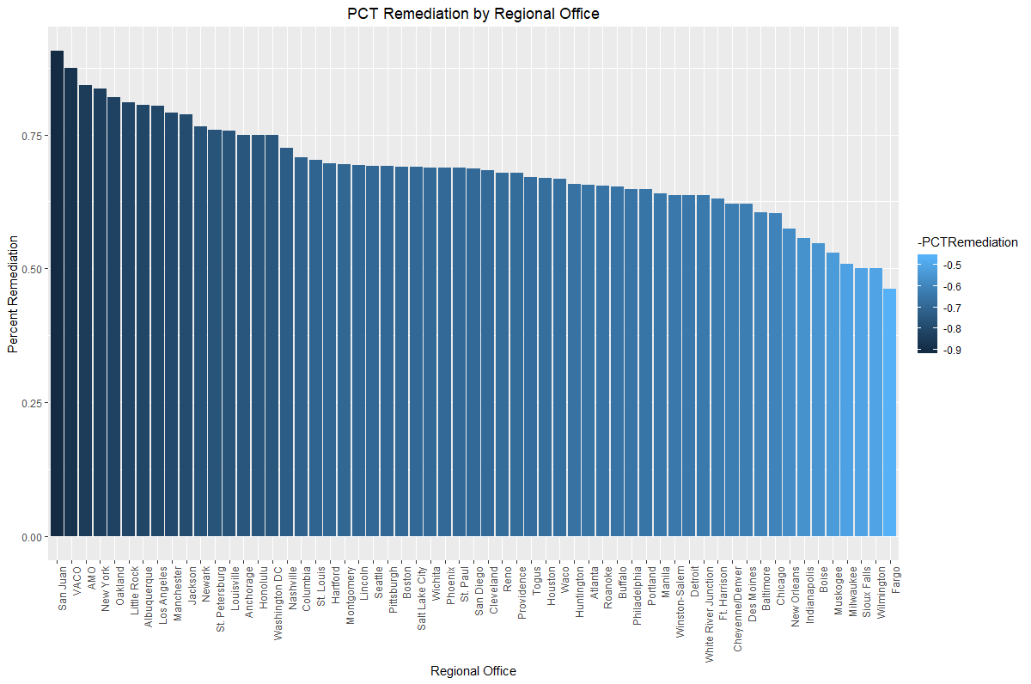
Question 4. Which Regional Offices required the most remediation?
Remediation = participants who failed to score a 100% on the pre-test and thus were required to go through the self-paced training. Remediation per region was calculated by finding the percentage of participants who failed the pretest.
Recommendation: Inspecting claims involving EMS procedures processed prior to November 2018 at regional offices that required the most remediation, as there may be a high number of errors in required actions, including those at the San Juan, central office, appeals office, New York, Oakland, Little Rock, Albuquerque, and Los Angeles offices.

Slide 7
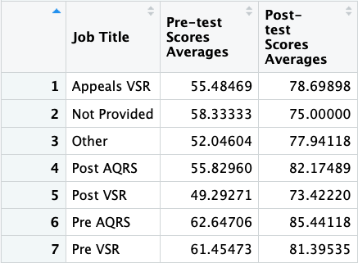
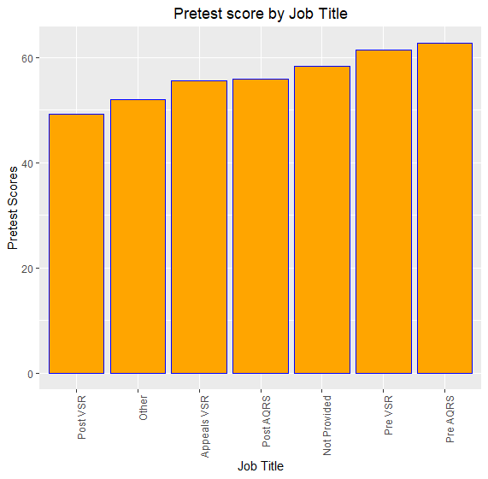
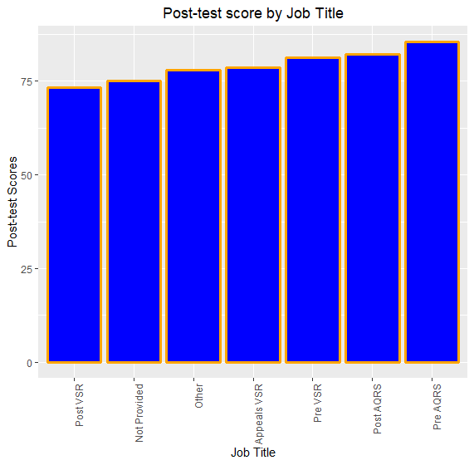
Question 5. What job categories scored higher or lower on the pre-test?
Between the 7 job categories (two of which are labeled as “Not Provided” and “Other”), the average scores for pre-test and post-test were measured. The Pre AQRS category had the highest average scores in both the pre-test and post-test while the Post VSR job category had the lowest scores across both tests.
Recommendation: Job Titles with average scores of 80% or above (Pre VSR(81.4%), PreAQRS(85.4%), Post AQRS(82.1%)) should be evaluated further to better understand what could have attributed to overall better scores from Pretest to Post-test.

Slide 8
Modeling
Ran two regressions to analyze the relationship between pretest score and experience level, and pretest score and district:
mod.exp <- lm(df.pretest$`Pretest Score` ~ df.pretest$`Demographic Question 3`)
mod.district <- lm(df.pretest$`Pretest Score` ~ df.pretest$District)
Results produced models with R-values of less than 0.05. For this reason, we chose not to perform machine modeling.

Slide 9
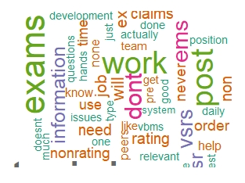
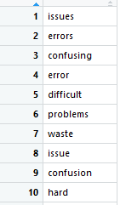
Question 6: What is the overall sentiment of training?
The total sentiment ratio of whether a participant would recommend training to their peers was overwhelmingly positive; however the negative sentiment was slightly higher than expected, 22%.
Recommendation: Work to address frequently used words to why a participant would not recommend training which suggests the relevancy of the tool between post-development positions and medical exams.
ratioNeg <- nNeg/totalWords
ratioNeg
[1] 0.2206749

Slide 10
Questions?

